Slide 1

Secure Authenticated Key Management Protocol for Cloud Computing
Department of Computer Science and Engineering
LINGAYAS INSTITUTE OF MANAGEMENT AND TECHNOLOGY
TEAM MEMBERS:
J. Chaitanya Venkata Sai Narayana(18NA1A0504)
R. Chandra Koushik(18NA1A0523)
R. Mahendar(18NA1A0534)
Ch. Sagar Babu(18NA1A0509)
Under the Guidance of: Head of the Dept:
Mr. B. Anil Kumar., M. Tech Mr. B. Anil Kumar.
(Asst.Professor)

Slide 2
Contents:
S.NO. | CONTENTS | SLIDE NO.
1. | Introduction | 3-4
2. | Objective | 5
3. | Synopsis | 6
4. | Existing System | 7-8
5. | Disadvantages | 9
6. | Proposed System | 10-11
7. | Advantages | 12
8. | Software Requirements | 13
9. | Our System Specifications | 14
10. | Flow Chart Diagram | 15-16
11. | Data Flow Diagrams | 17-19
12. | Implementation | 20-29
13. | References | 32

Slide 3
INTRODUCTION
In the recent decade, cloud computing technology has been completely commercialized. It can not only improve service efficiency but also reduce costs. More and more companies are putting their services on the cloud platform for development, management and maintenance.
This not only reduces the local maintenance burden for these enterprises, but also provides unified security and operation management for all services on the third-party cloud platform.

Slide 4
Although these platforms have more powerful technologies and more standard technical specifications to ensure that the servers run in a relatively secure environment, users and servers communicate in the public network. Therefore, authentication and key agreement are critical for the communication security.

Slide 5
OBJECTIVE
In this project our main objective is to provide Security Protocol for Cloud Computing.
Authentication

Slide 6
SYNOPSIS
The maturity of cloud computing technology in terms of reliability and efficiency, a large number of services have migrated to the cloud platform.
To convenient access to the services and protect the privacy of communication in the public network, three-factor Mutual Authentication and Key Agreement (MAKA) protocols for multi-server architectures gain wide attention.

Slide 7
EXISTING SYSTEM
Earlier (MAKA) Mutual Authentication and Key Agreement protocols are designed for single-server architecture.
As Internet users grow exponentially, the number of cloud servers rendering different services has also grown significantly. For the single-server architecture, it is difficult for users to maintain a variety of passwords for each server.

Slide 8
To improve user experience, many scholars propose more flexible MAKA protocols for multi-server environments. Combined with the unified management features of the cloud platform, such protocols can be conveniently applied.

Slide 9
Disadvantages
In the multi-server environments, the (MAKA) Mutual Authentication and Key Agreement protocols can be further divided into two categories, two-factor MAKA protocols, namely identity, password, and three-factor MAKA protocols, namely identity, password, biometrics.
The password- based MAKA protocols suffer from several attacks such as guessing password attack.

Slide 10
PROPOSED SYSTEM
We propose a Dynamic Revocable Three-Factor Mutual Authentication and Key Agreement (3DRMAKA) protocol which has more comprehensive functions, reliable security and relatively higher execution efficiency. Our contribution can be summarized as follows:
We design a three-factor (MAKA ) Mutual Authentication and Key Agreement which implements three-factor security.

Slide 11
Our scheme achieves the user’s dynamic management.
Without a dynamic revocation mechanism, (RC) Registration center can’t punish malicious users in a timely manner. This may result in such malicious users still active in the network to communicate with other servers.
In our protocol, users can be dynamically revoked to promptly prevent attacks from malicious users.

Slide 12
Advantages
Proposed protocol can meet the demands of multi-server architectures such as anonymity, non traceability, resistance password guessing attack and smart card extraction attack.
On the other hand, the MAKA protocol is also widely used in other environments, such as Passive Internet of Things.

Slide 13
System Specification
Hardware Specifications:
RAM - 4 GB
Hard Disk - 20 GB
Processer - Intel Core i3 with 2.4 GHz.
Software Requirements:
Coding Language - Java/J2EE (JSP, Servlet).
Front End - J2EE 8.0.
Back End - HeidiSQL 9.4.0.5125.

Slide 14
OUR SYSTEM SPECIFICATIONS
Hardware Specifications:
RAM - 16GB
STORAGE - 10128 GB
Software Specifications:
Coding Language - Java
Back End - MySQL

Slide 15
FLOW CHART DIAGRAM
OWNER
UPLOAD FILES
Upload to reg cloud server
No
Cannot upload
yes
Store files in corresponding cloud
Cloud server

Slide 16
Check files name or Secret key
Wrong
File Name or skey not correct
correct
Access Files
File Name or skey not correct
Correct Files name or Secret key
Download File
RECEIVER

Slide 17
DATA FLOW DIAGRAM
Cloud server 1
Selects cloud server
REGISTER
DATA OWNER
Cloud server
Cloud server 2
Cloud server 3
Cloud server 4

Slide 18
Cloud server 1
Cloud server 2
REGISTER
Cloud server
DATA OWNER
Cloud server 3
Provides login operation for data owner
Truest manager
Cloud server 4
View all cloud files

Slide 19
REGISTER FILE
CLOUD CONSUMER
CLOUDSERVERS(CS1,CS2,CS3,CS4)
Check fname and sk
Authorize the file
T
F
Enter correct filename or secret key

Slide 20
Implementation
DATA OWNER:
In this module, initially the data owner has to get register to the cloud server. Data owner will login to the corresponding cloud server he got registered.
Data owner encrypt will upload file to the cloud server Data owner verifies the file he uploaded either it is correct or not.
Data owner can view, how many file has been uploaded to the corresponding cloud servers Data owner will send file to trust manager to store the data owner file to the corresponding cloud servers.

Slide 21
Implementation
CLOUD SERVER:
The cloud server manages a cloud to provide data storage service. Data owners encrypt their data files and store them in the cloud for sharing with cloud consumer.
To access the shared data files, data consumers download encrypted data files of their interest from the cloud and then decrypt them.
TRUST MANAGER :
Trust manager provides login authorization for both data owner and the end user.
ATTACKER:
Attacker will view registered users and cloud files.

Slide 22
Implementation
CLOUD CONSUMER:
Cloud consumer first has to register to the cloud server which particular cloud he has to use.
Cloud consumer has to login to the cloud he got registered.
Cloud consumer feedback about the data (positive or negative feedback).

Slide 23
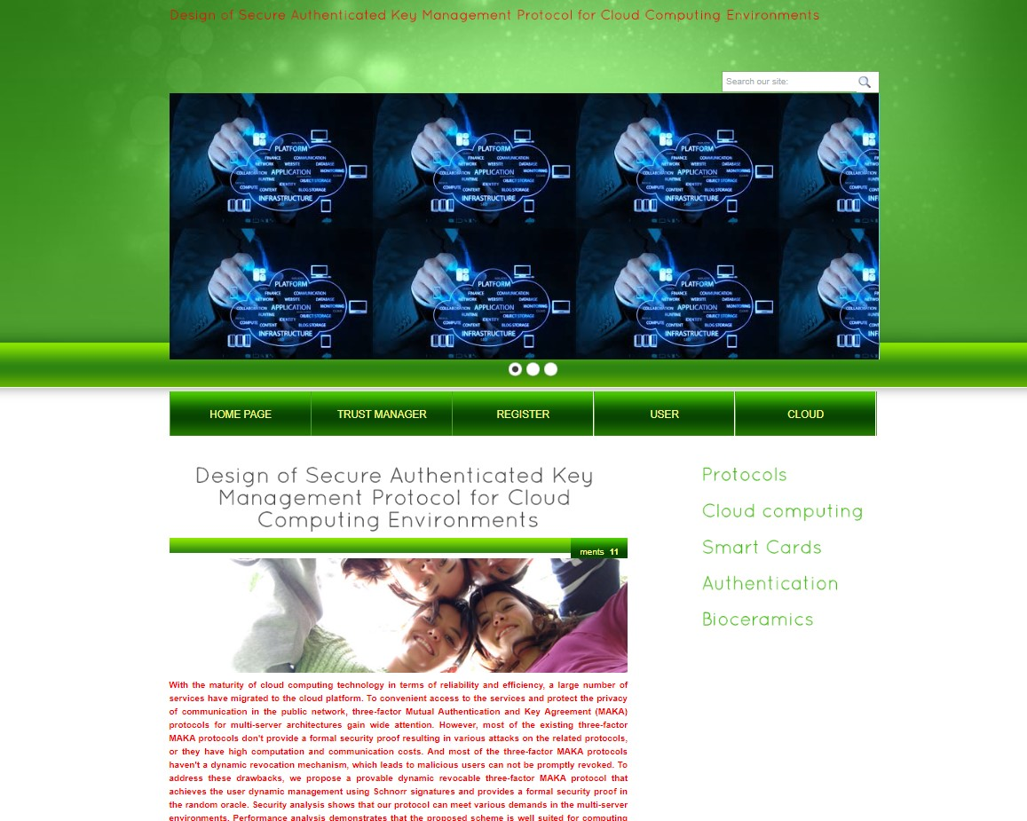
Home Page
This page shows all the contents that the user as well as Trust Manager is going to access.

Slide 24
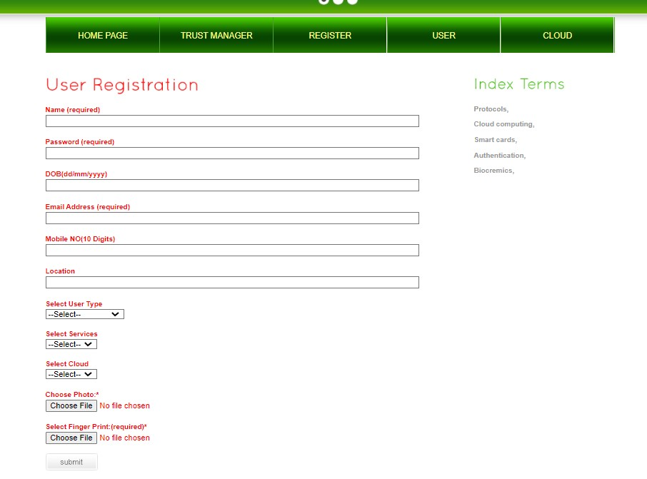
User Registration page
User need to provide all the details that are required to create an account in the data base

Slide 25
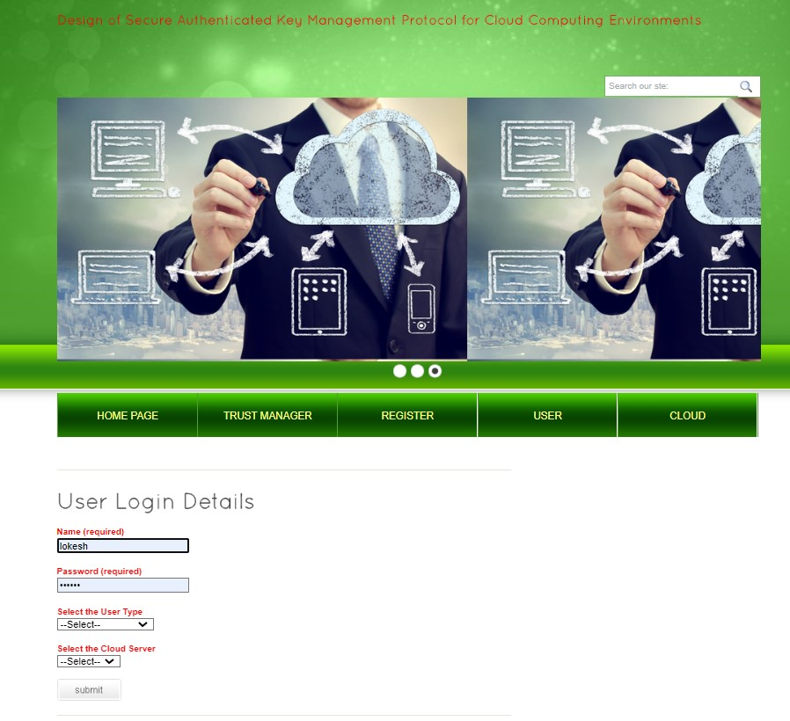
User login page
User can login into his account using the login credentials

Slide 26
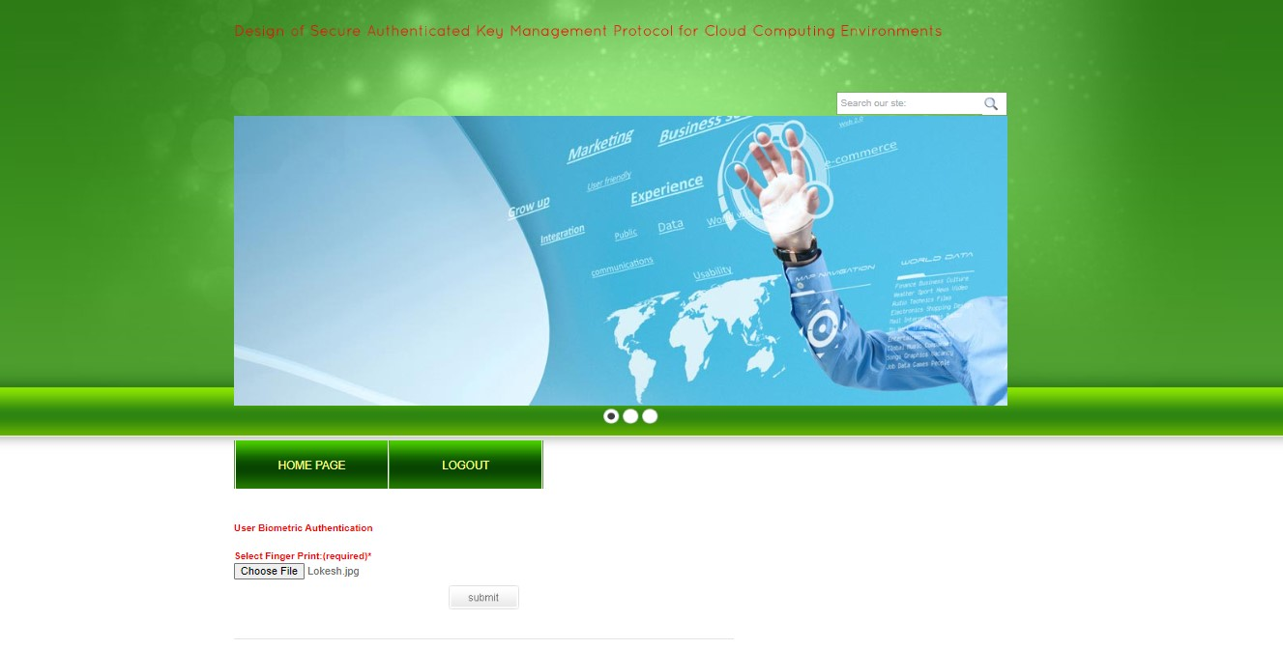
Key Authentication page for user
User need to give the authenticated finger print that the user has given during the registration phase

Slide 27
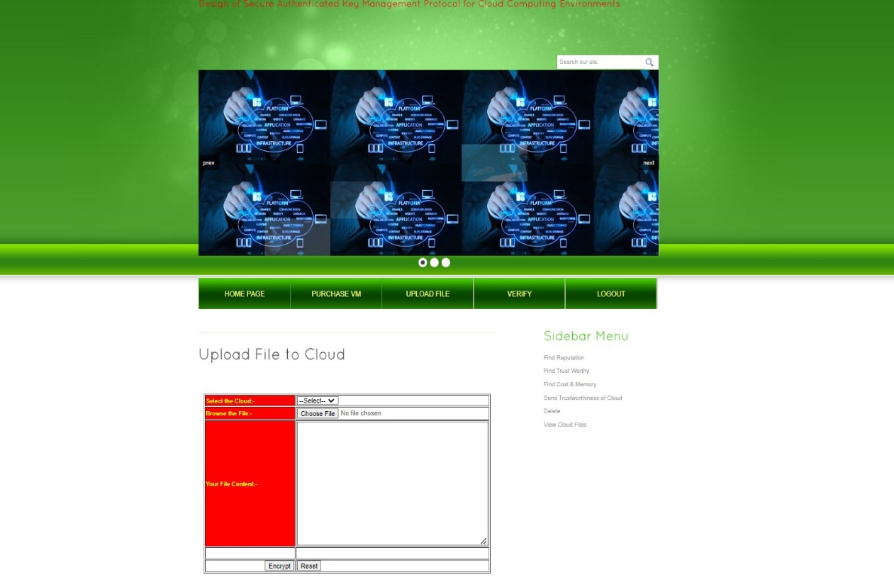
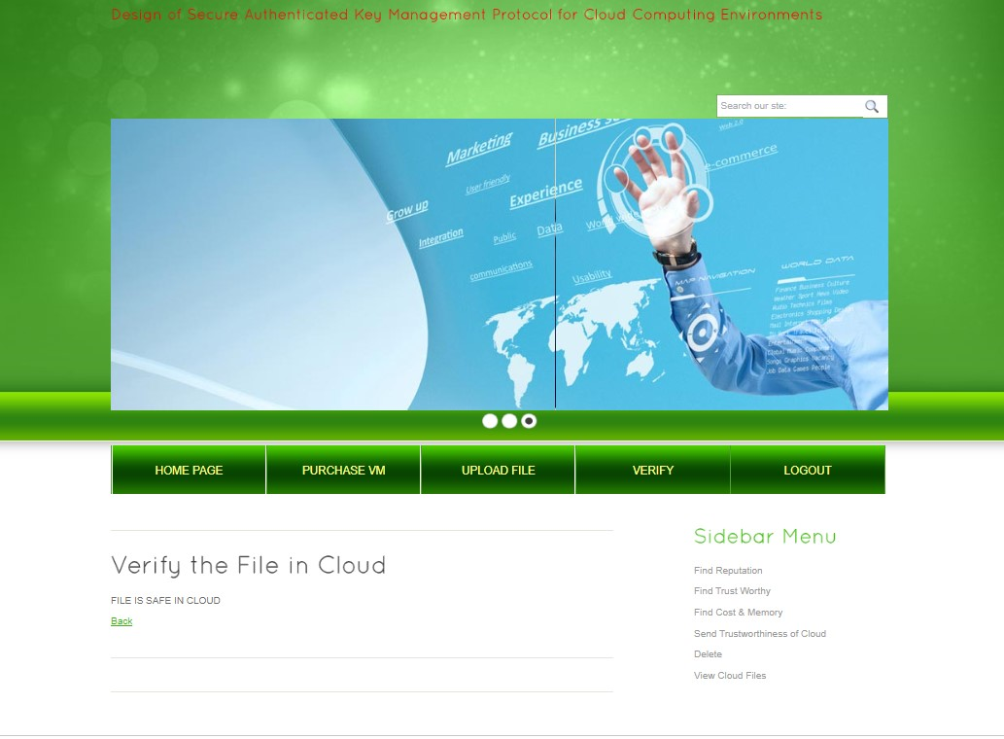
User File Upload Page

Slide 28
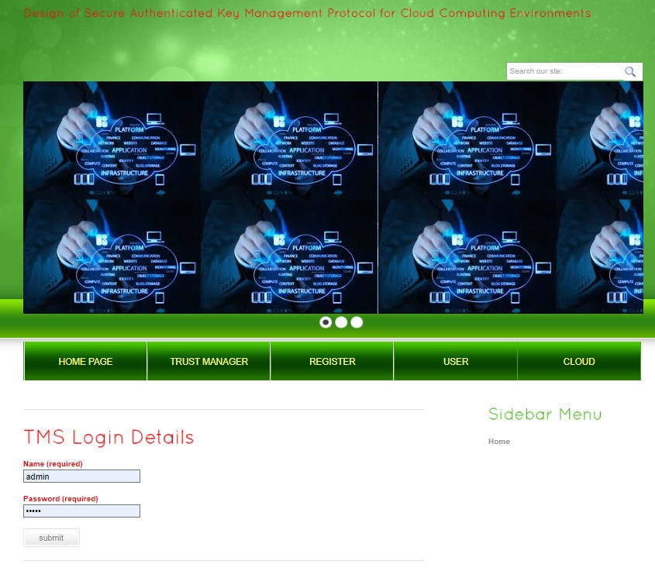
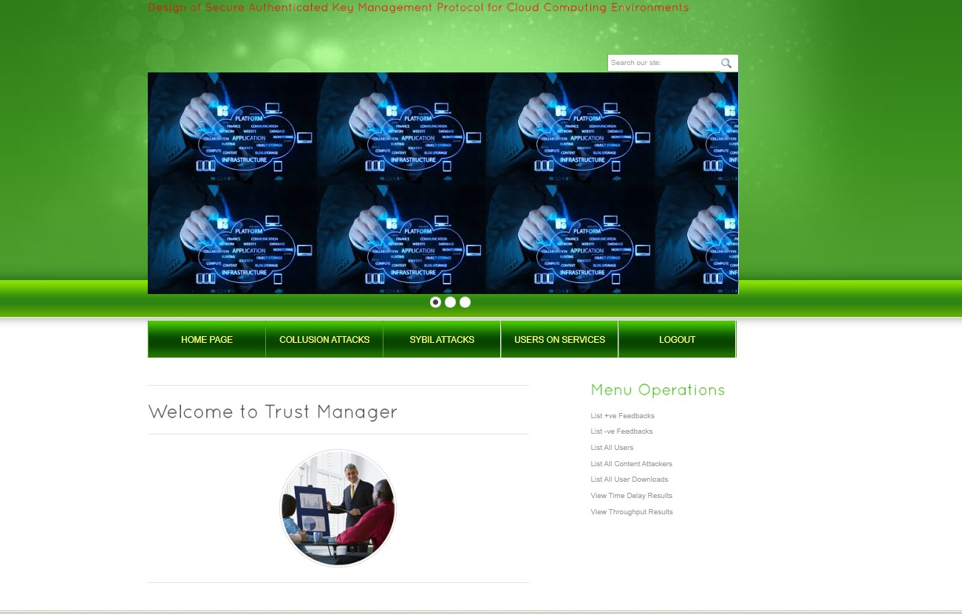
Trust Manager Page

Slide 29
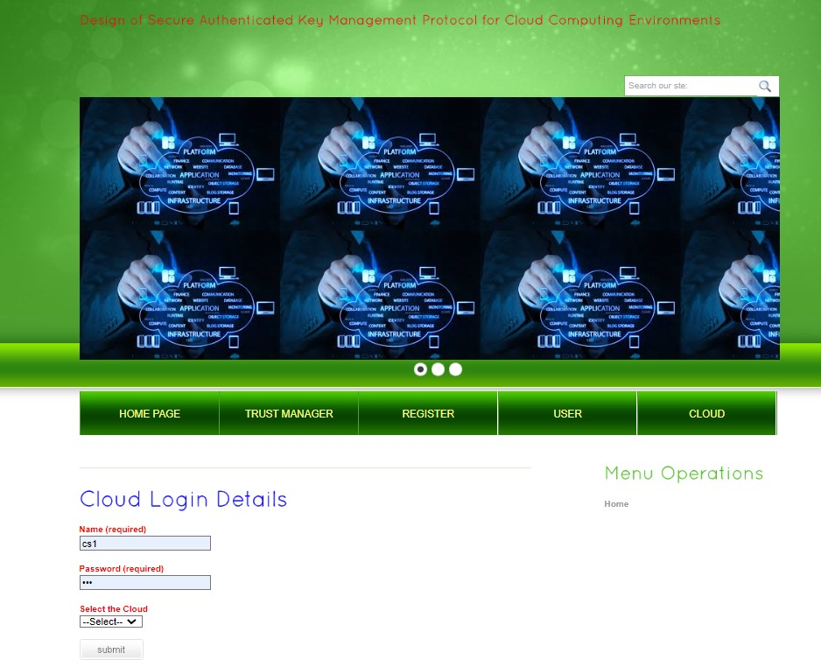
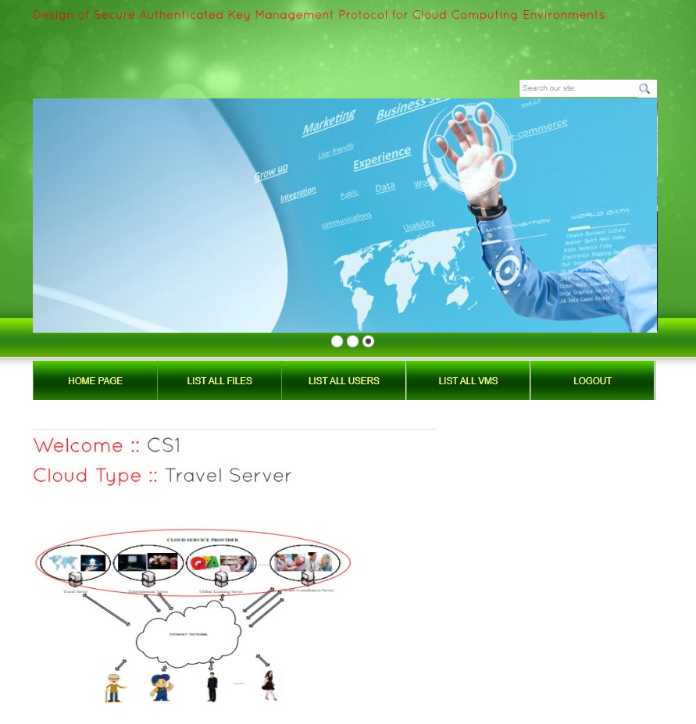
Cloud login page

Slide 30
Conclusion
To resist the exhaustion of password attack on the two-factor MAKA protocols, a large number of three-factor MAKA protocols have been proposed. However, almost all three factor MAKA protocols don’t provide formal proofs and dynamic user management mechanism. In order to achieve more flexible user management and higher security, this paper proposes a new three-factor MAKA protocol that supports dynamic revocation and provides formal proof.

Slide 31
Future Scope
Currently we have developed this project by just uploading the fingerprint scans instead scanning the finger prints using biometric devices.
So in future this project can be collaborated with IOT.

Slide 32
References
[1] S. Rojas-Galeano, “On obstructing obscenity obfuscation,” ACM Transactions on the Web (TWEB), vol. 11, no. 2, p. 12, 2017.
[2] Hate-Speech, “Oxford dictionaries,” retrieved August 30, 2017 from https://en.oxforddictionaries.com/definition/hate speech.
[3] P. Burnap and M. L. Williams, “Cyber hate speech on twitter: An application of machine classification and statistical modeling for policy and decision making,” Policy & Internet, vol. 7, no. 2, pp. 223–242, 2015.

Slide 33
Queries?

Slide 34
THANK YOU

